Slide 1

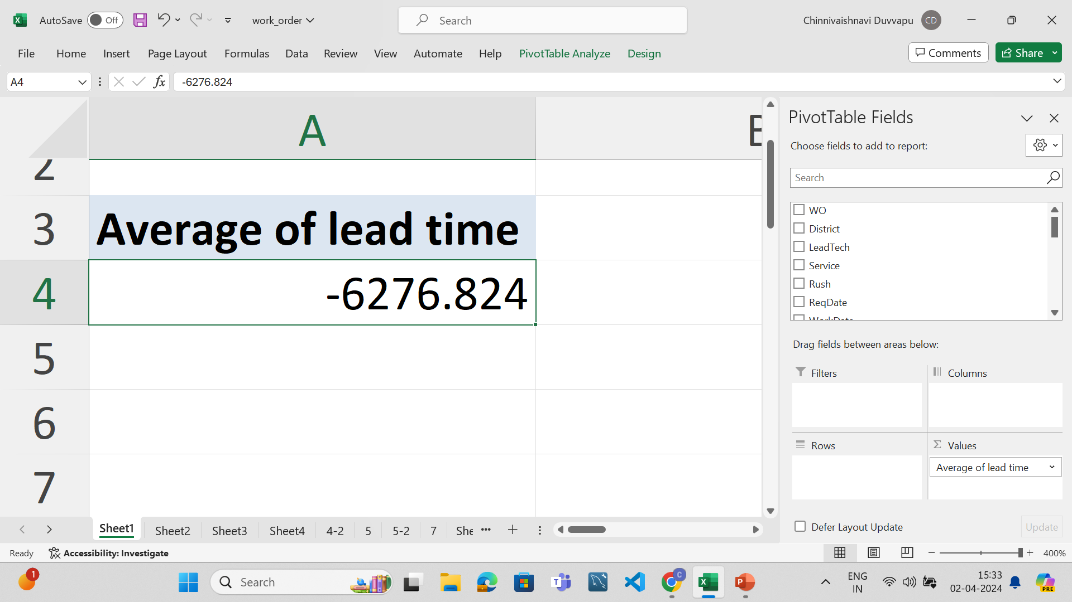
1.
TITLE: Average lead time between request date and completion date for all orders
METHOD USED:Checked both in pivot table and normally(average of the new column i.e., (work data –req date)
ANALYSIS:The average lead time between request date and completion date for all orders is -6276.824

Slide 2
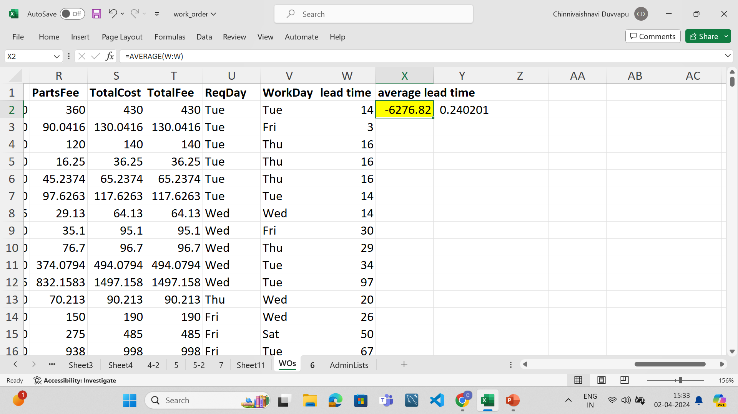
NORMAL METHOD:

Slide 3
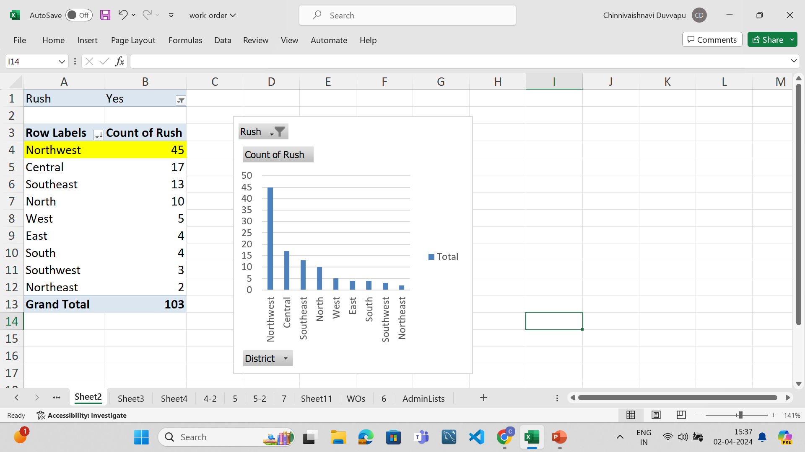
2.
TITLE: DISTRICT WITH HIGHEST NUMBER OF RUSH JOBS
METHOD USED: Pivot table
OBSERVATION: North-west is the district with the highest number of rush jobs

Slide 4
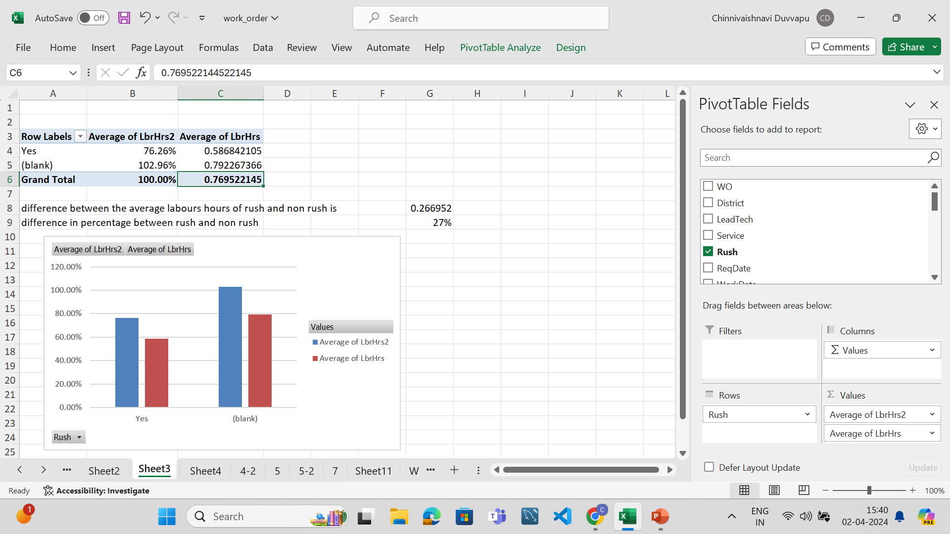
3.
TITLE:DIFFERENCE BETWEEN AVERAGE LABOUR HOURS BETWEEN RUSH AND NON RUSH JOBS
METHOD USED:Pivot table
OBSERVATION:Difference between average labour hours between rush and non rush jobs is 0.266952 .
In terms of percentage the difference is 27%.
Non rush jobs have more average labour hours than rush jobs.

Slide 5
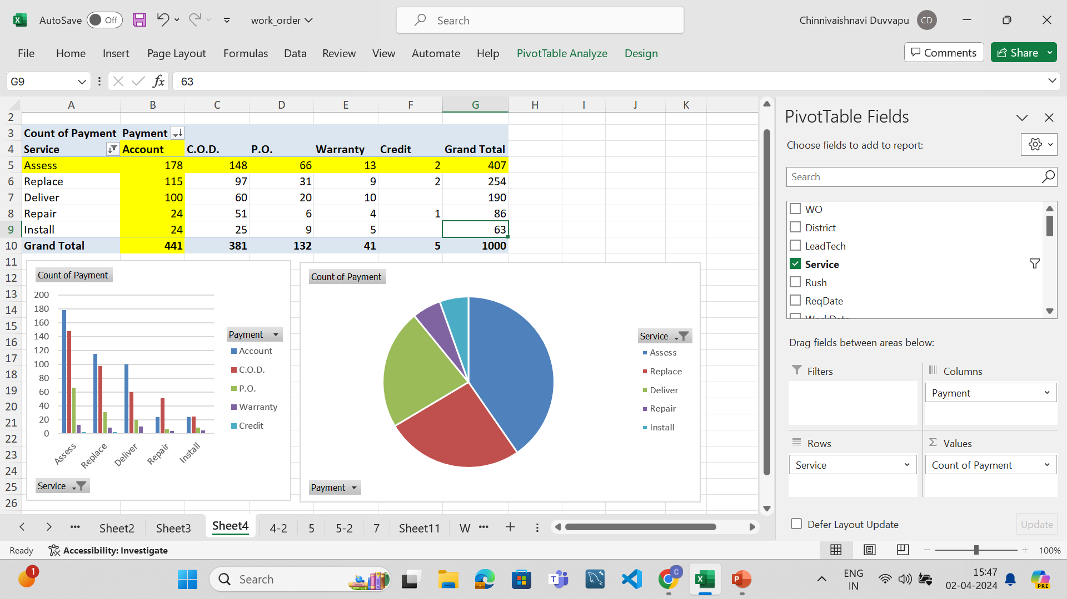
4.
TITLE:DISTRIBUTION OF PAYMENT TYPES ACROSS DIFFERENT SERVICES
METHOD USED:Pivot table
OBSERVATION:The distribution of various payment types across different services is as shown in below picture.The service “ASSESS” and payment type “ACCOUNT” together have the highest distribution among all.”INSTALL” and “WARRANTY” have lowest distribution.

Slide 6
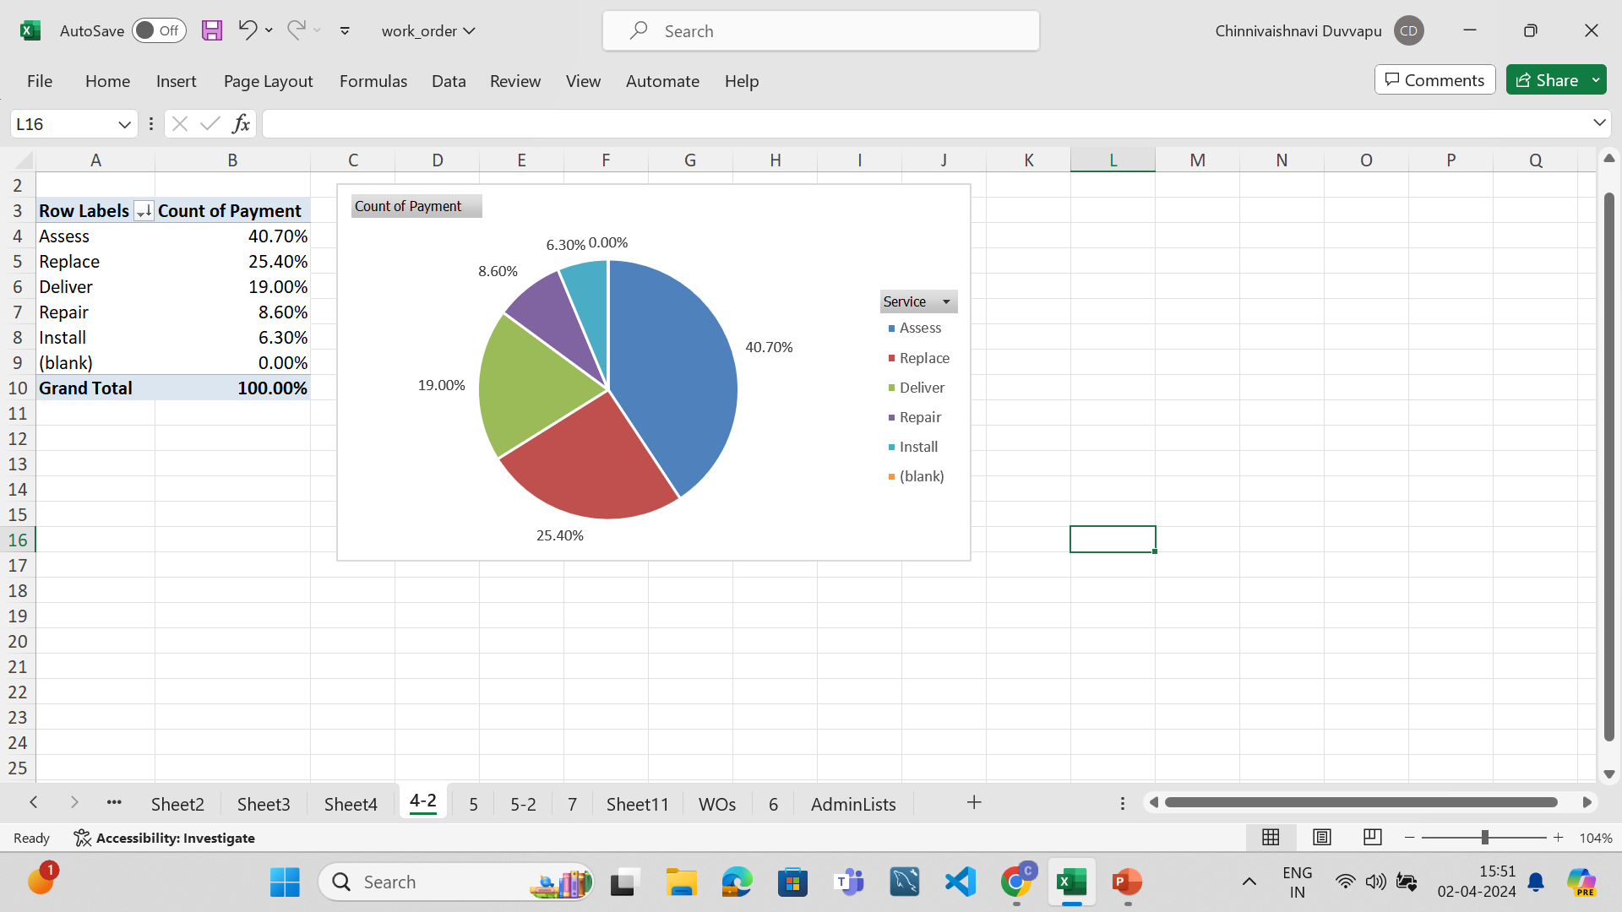
From the below picture we can say that Asess has highest distribution which is 40.70% of payment while Install has the least i.e., 6.30%

Slide 7
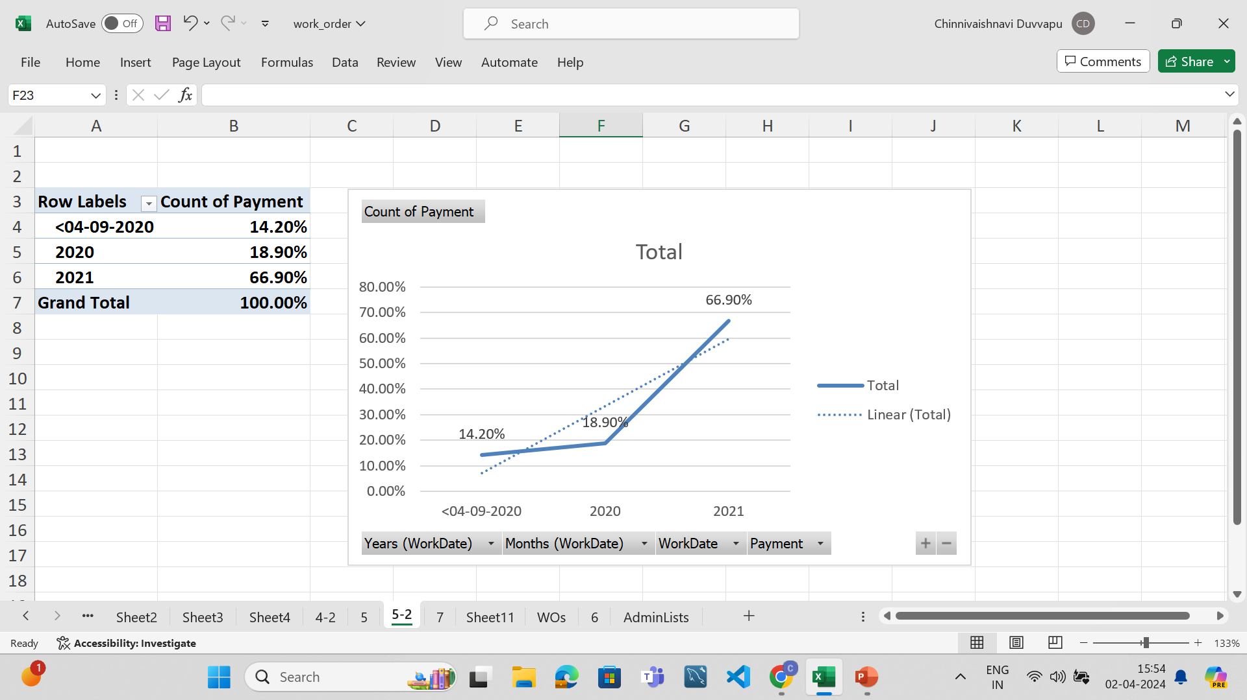
5.
TITLE:TRENDS IN DISTRIBUTION OF PAYMENT TYPES OVER TIME
METHOD USED:Pivot table
ANALYSIS: The distribution of payment types increased over the years.The increase is rapid from 2020-2021

Slide 8
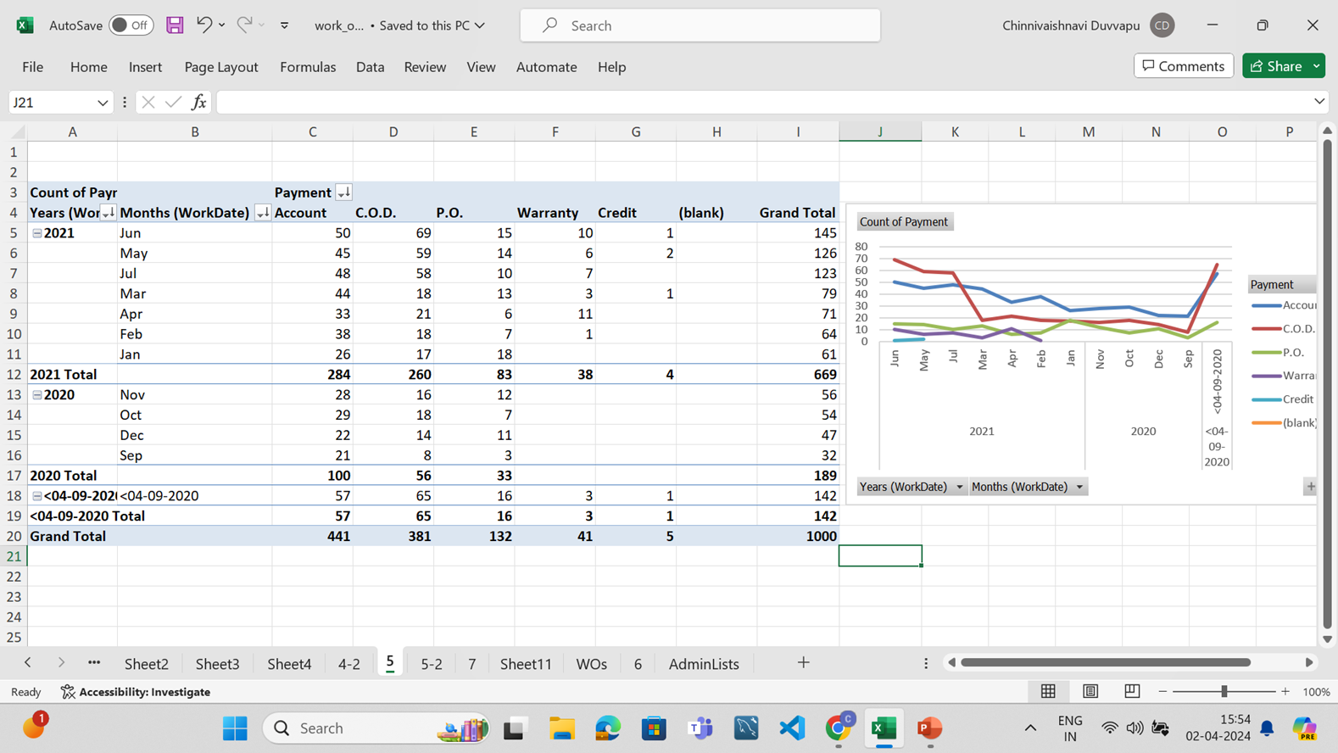
The distribution of different payment types can be seen below

Slide 9
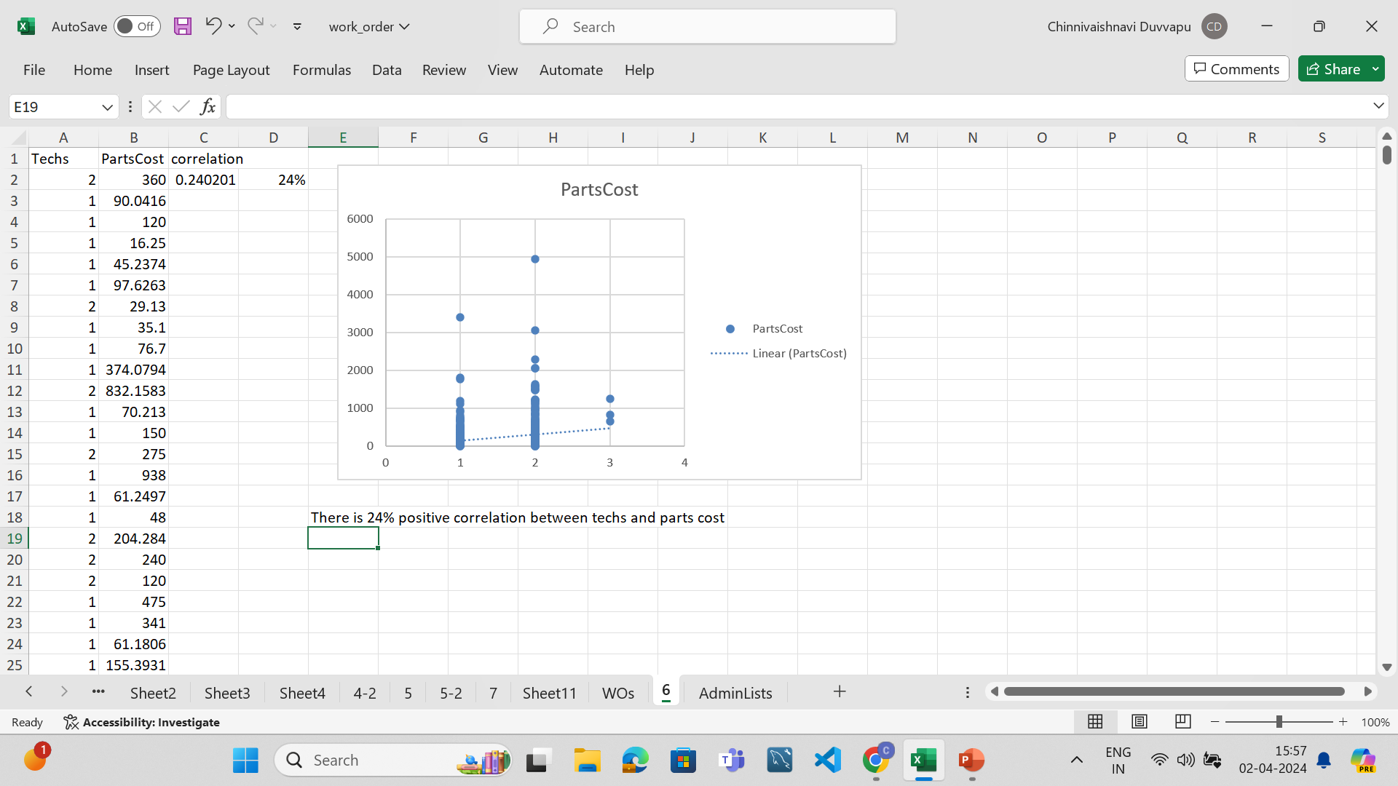
6.
TITLE:RELATION BETWEEN NUMBER OF TECHNICIANS REQUIRED AND COST OF PARTS
METHOD USED:Used CORREL() function
OBSERVATION:There is a 24%positive correlation between number of technicians and cost of parts. As the correlation value 0.2402 is near to zero there is correlation but it is less.

Slide 10
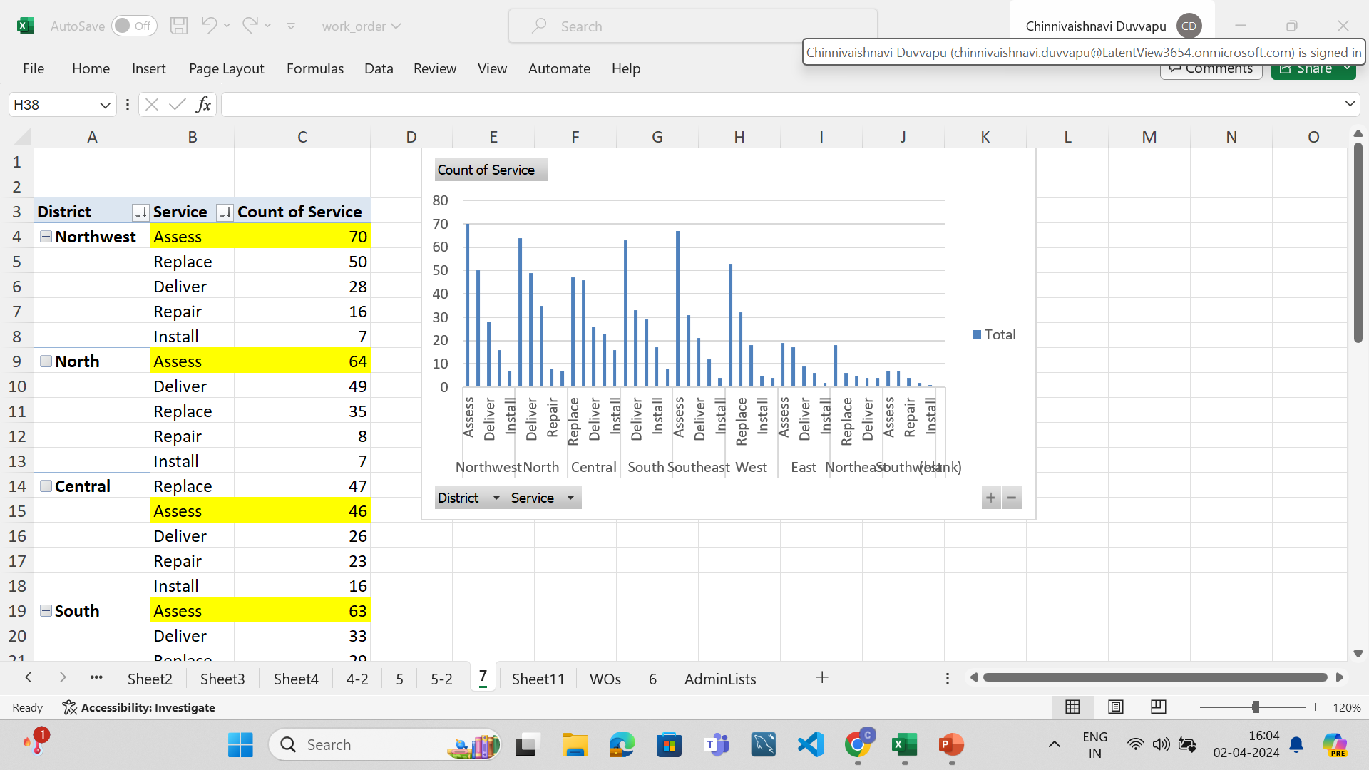
7.
TITLE:MOST COMMON TYPE OF SERVICE REQUESTED IN EACH DISTRICT
METHOD USED:PIVOT TABLE
ANALYSIS:

Slide 11
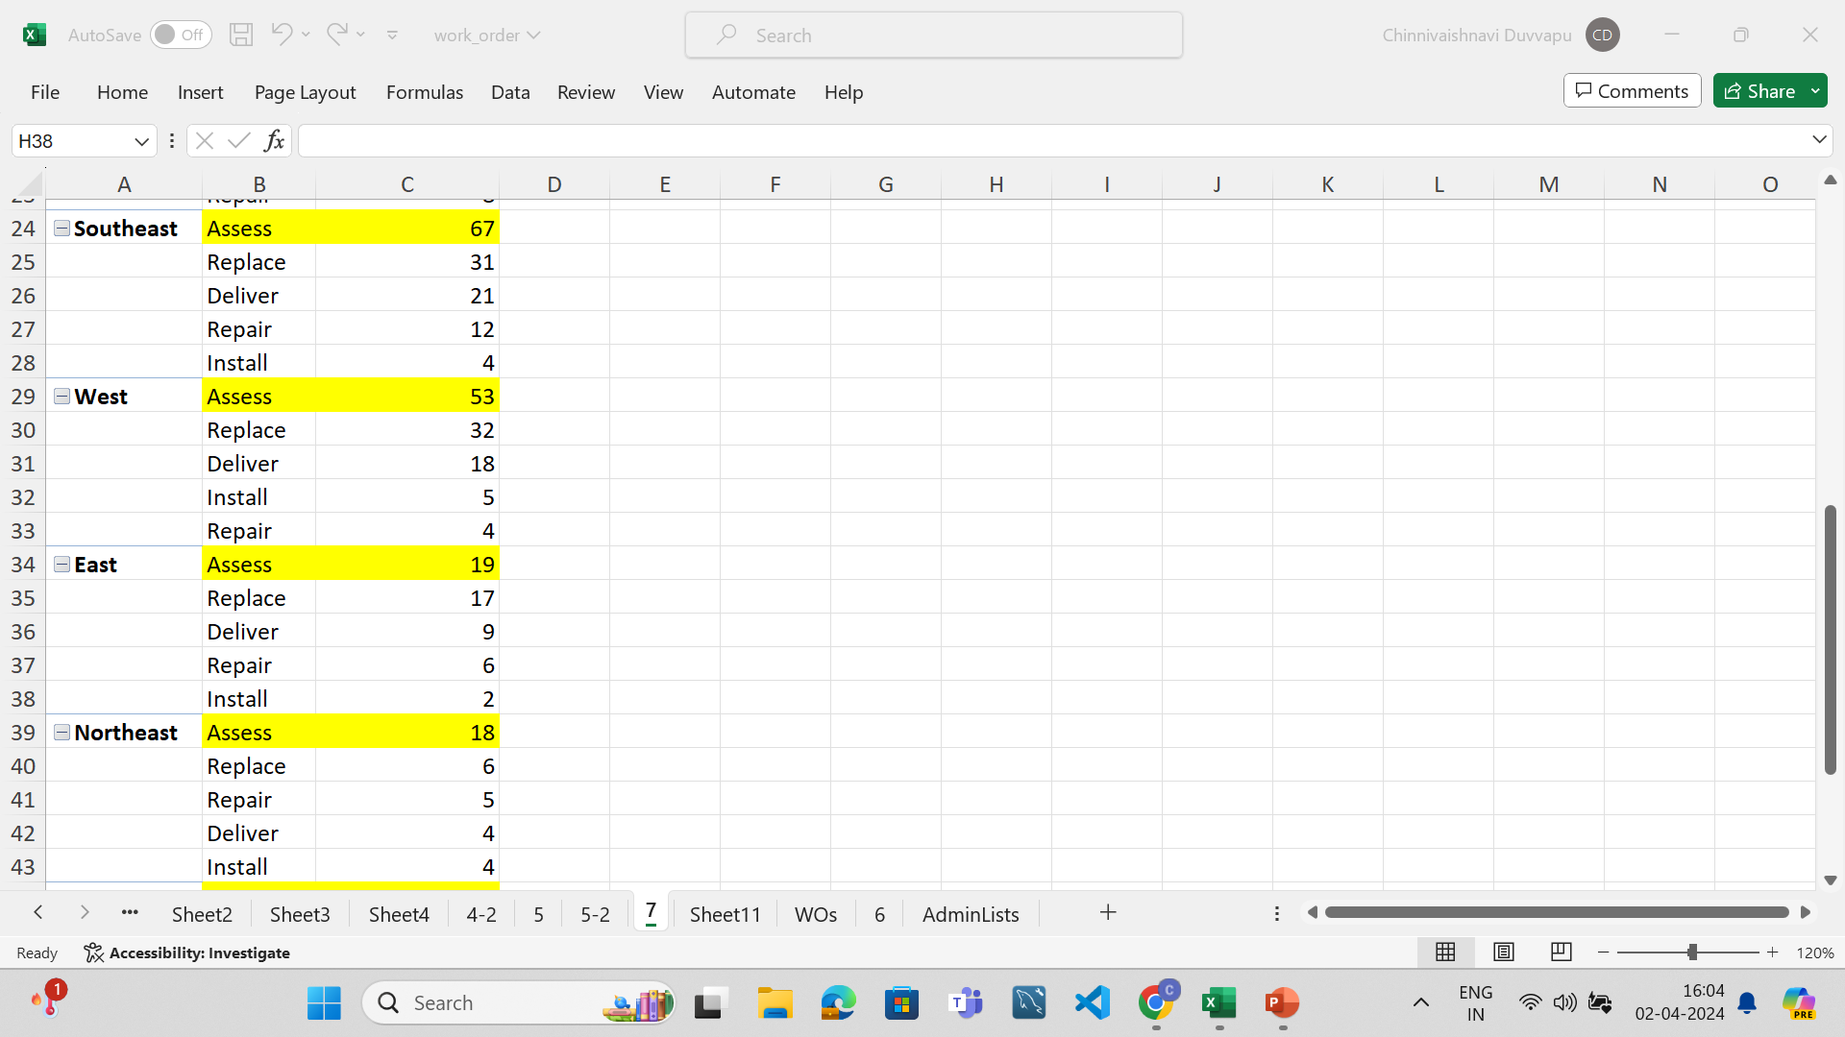

Slide 12
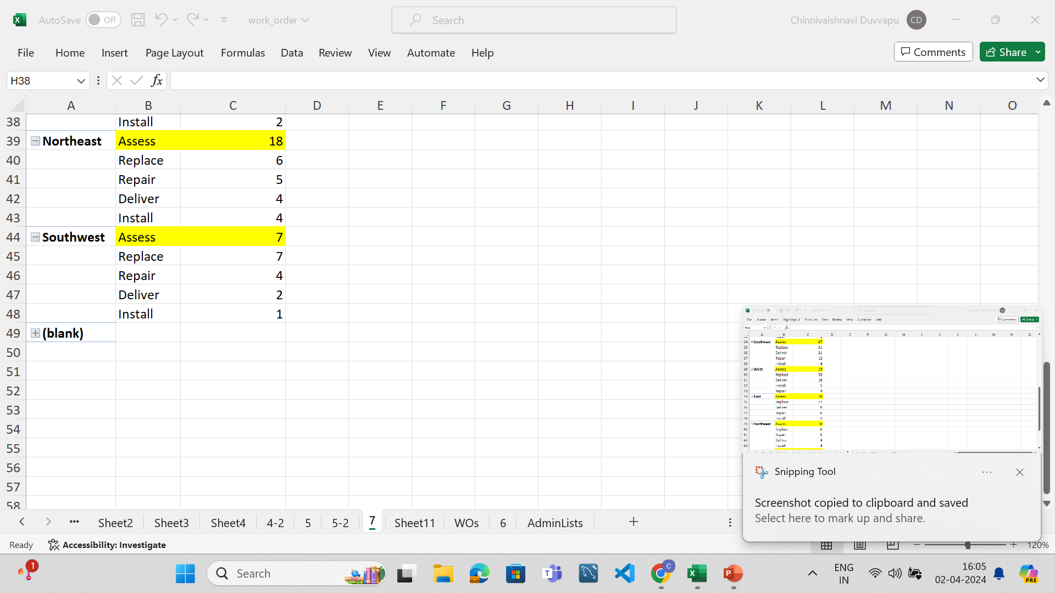

Slide 13
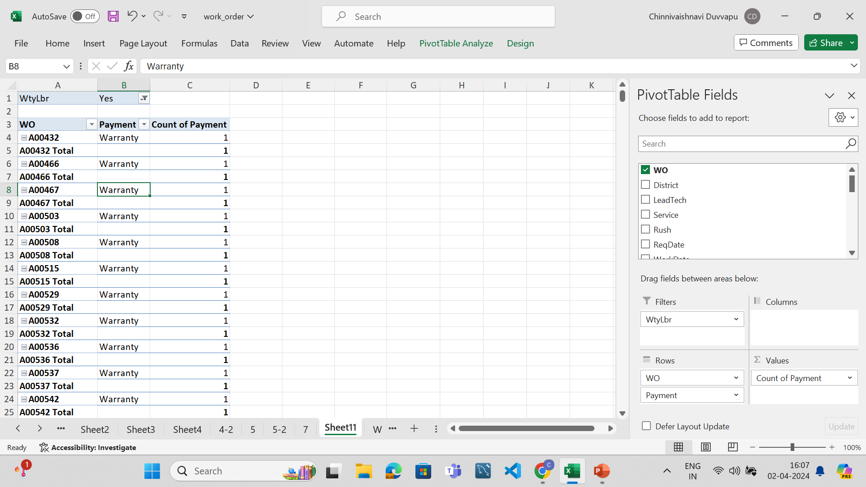
8.
TITLE:DISTRIBUTION OF PAYMENT TYPES FOR WITH AND WITHOUT WARRANTY LABOUR
METHOD USED:PIVOT TABLE
ANALYSIS:When there is warranty labour, The work orders used only WARRANTY payment type.
When there is no warranty labour, the work orders are of ACCOUNT, COD, CREDIT, PO.

Slide 14
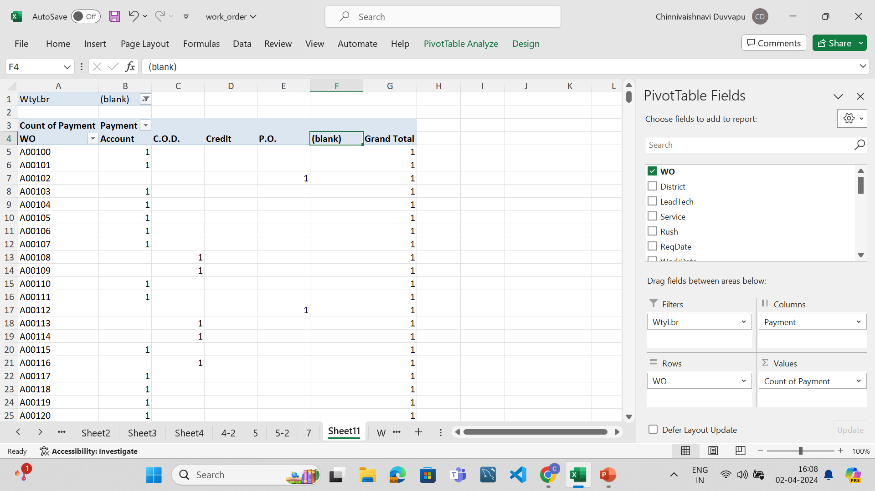

Slide 15
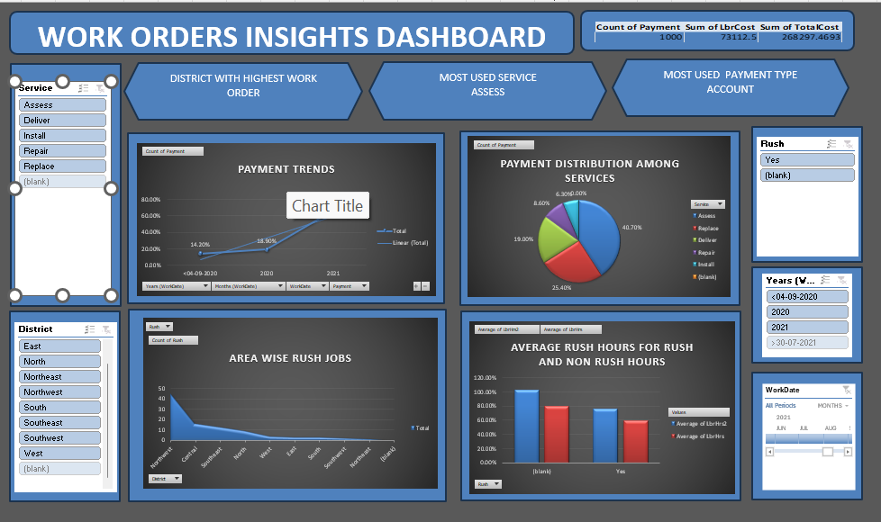
9.DASHBOARD

Slide 16
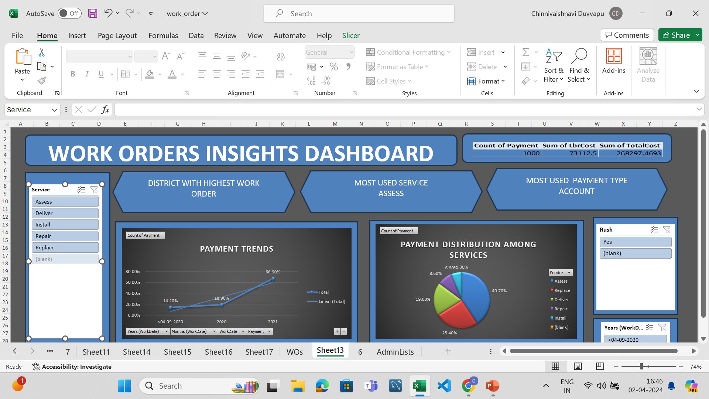

Slide 17
